Slide 1
Ready 2026:
ADA Compliance
Drew Vincent, Mitzi Shipley, Trista Moxley
Notes:
Updated 2/12/26

Slide 2

New Legal Requirements
Americans with Disabilities Act (ADA), Title II
By April 24 - all UT San Antonio digital platforms and documents must comply with accessibility standards. This applies to every employee.

Slide 3
What Digital Content Does This Cover?
Word, Excel, PowerPoint, PDFs
Web pages
Course Materials
Online forms
Emails, newsletters, announcements
SharePoint or Teams sites
Intranet pages, file libraries
Training materials, meeting slides, reports
Digital signage, flyers, event promotions
Videos
Webinars
Recorded presentations
Recorded ceremonies
Templates and branded materials
Social media content and digital outreach posts shared on official university accounts
Any externally shared digital resources provided to community partners

Slide 4

What Happens
If We Miss The Deadline?
UT San Antonio may face potential financial penalties, while your team may face business interruptions and court mandated changes to content.

Slide 5
What’s My Goal?
The legal requirement is 100% compliance. Striving for substantial conformance can help you get there.
Substantial Conformance means that your content doesn't have critical accessibility barriers preventing users with disabilities from accessing it. While minor issues may still exist, they should not create significant obstacles for users.
Faculty Specific: Work toward an Ally score of 85% or higher by April. Ally is an automated course accessibility tool, integrated within our Learning Management System.

Slide 6
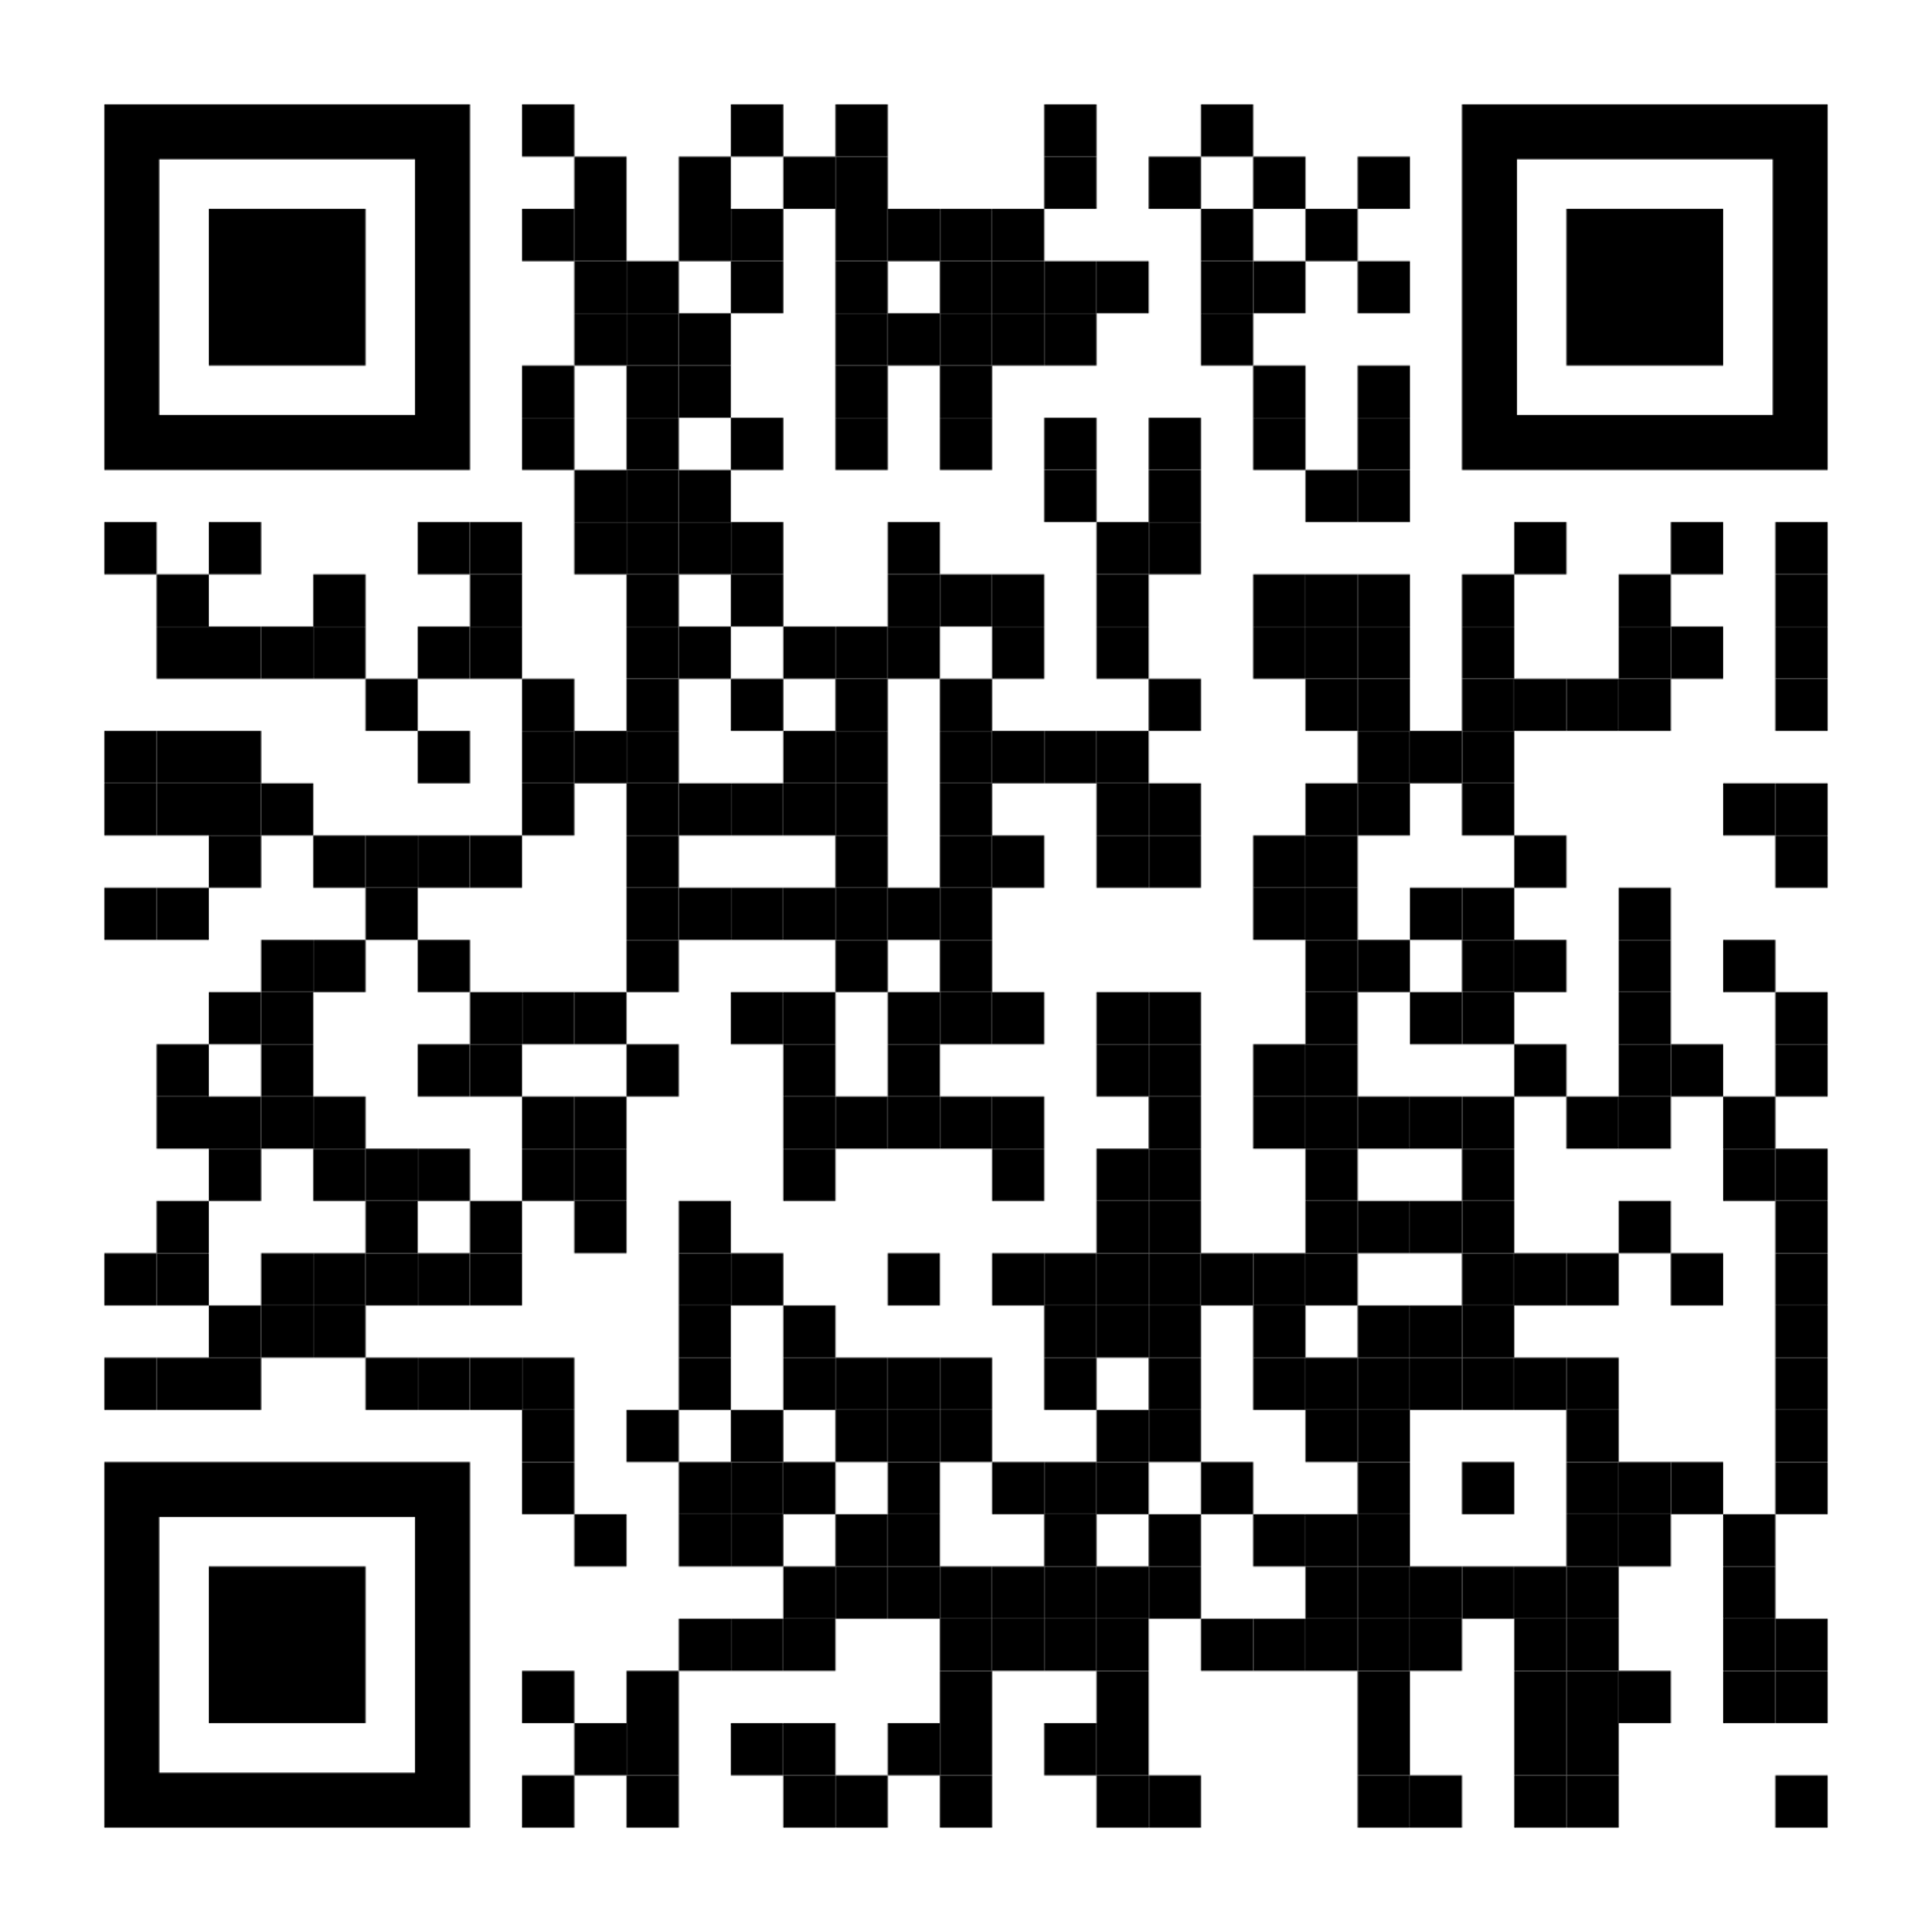
Getting Started
Your Journey Begins Here
The university’s ADA team has developed detailed pre-built plans, trainings, tools, and more broken down by the programs and materials that you use every day
Scan the code or visit
www.utsa.edu/ada/compliance2026/resources.html

Slide 7
Design Considerations
ACTION STEPS

Slide 8
Video Captions - Style Guidelines
Font: Sans-serif (e.g., Arial, Helvetica) for readability; avoid all-caps
Color: White text on semi-transparent black or brand blue (#032044) background
Logical Breaks: Break lines at natural points (commas, periods); don’t split names or titles
Position: Bottom-center of video; move to top only if lower third is obstructed
Static Text: Keep captions in one position; display long enough to read (≈3 words/sec). Avoid scrolling or flashing
Safe Margins: Keep text within the Title Safe Area (usually the inner 80% of the screen). If text is too close to the edge, it may be cut off by app UI (like the TikTok "Like" button).
Size: Relative to the resolution of your sequence

Slide 9
Video Captions - Font Sizes
Resolution | Large / "Social"
1080p (1920x1080) | 80 – 115 px
4K (3840x2160) | 160 – 230 px
Notes:
Netflix requires captions to be "relative to the video resolution," focusing on the ability to fit exactly 42 characters across the screen.
BBC – 8% Rule - A single line of text should be approximately 8% of the player height.

Slide 10
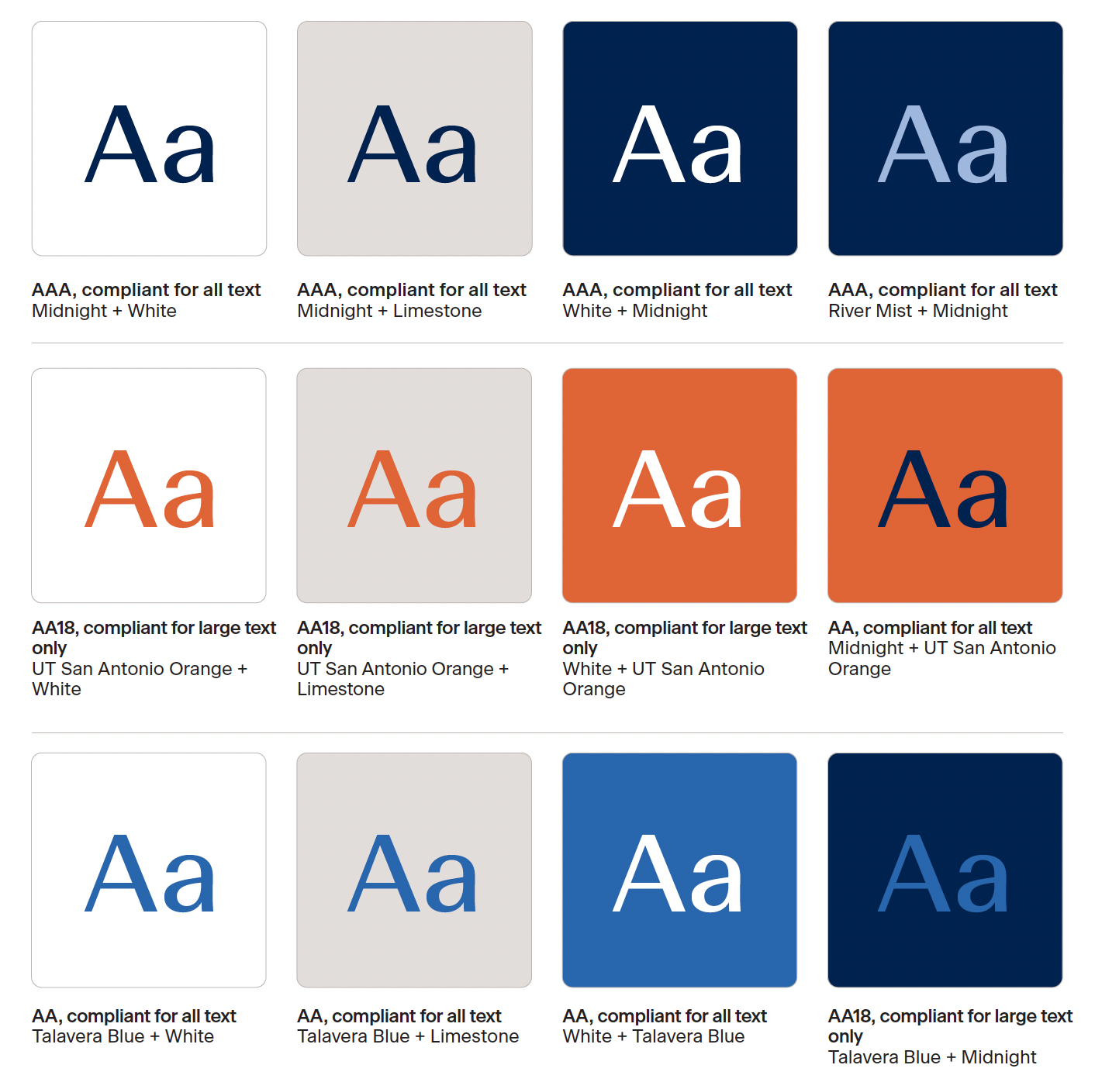
Color Contrast
WCAG recommends minimum contrast ratio of 4.5:1 for text and graphics.
Large-scale text and images of large-scale text must have a contrast ratio of at least 3:1
Large text is defined as 14 point (typically 18.66px) and bold or larger, or 18 point (typically 24px) or larger.
Brand Color Palette and Accessible Color Pairings
Contrast Checker
Notes:
The intent is to provide enough contrast between text and its background, so that it can be read by people with moderately low vision or impaired contrast perception, without the use of contrast-enhancing assistive technology. Talk about orange on video

Slide 11

Color Contrast
Text with no contrast requirements
Purely decorative text
Text that is part of a picture containing significant other visual content
Text that is part of a logo or brand name
Notes:
The intent is to provide enough contrast between text and its background, so that it can be read by people with moderately low vision or impaired contrast perception, without the use of contrast-enhancing assistive technology. Talk about orange on video

Slide 12
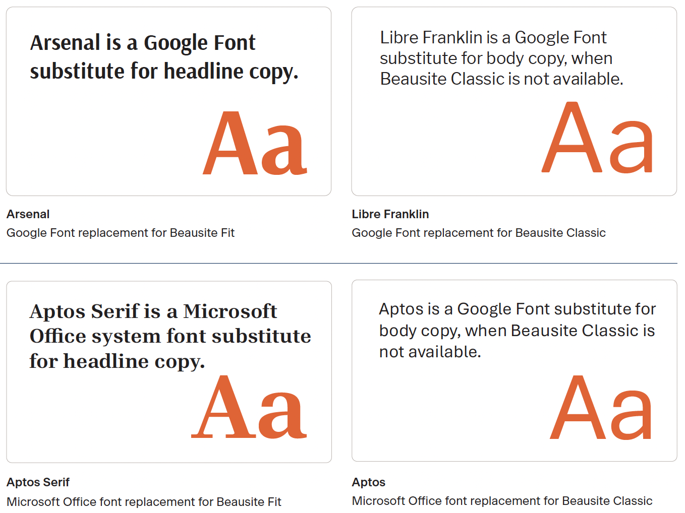
Brand Fonts for Video Graphics
Standard Text:
Beausite Classic (preferred), Aptos, Libre Franklin
Large Graphics (Optional):
Beausite Fit or Arsenal for visual interest
Ensure readability and contrast compliance
Use only for short headlines or hero graphics—not captions or body text
Should meet WCAG contrast ratios (≥ 4.5:1 normal text; ≥ 3:1 large text)
Use sparingly; keep sans-serif fonts dominant
Avoid overly condensed or stylized weights
Notes:
four point five to one, three to one

Slide 13
Social Media Compliance
ACTION STEPS
Notes:
Strive for Substantial Conformance - means that your content doesn't have critical accessibility barriers preventing users with disabilities from accessing it. While minor issues may still exist, they should not create significant obstacles for users.

Slide 14

Did You Know?
3.2 billion images are shared on social media daily, according to Vision Australia.
Making posts accessible connects people to important information and announcements, data and statistics, entertainment, and culture.

Slide 15
Social Media Exception
If a post was published on social media before April 24, 2026, it is not required to comply with these new guidelines.​
However, you may still have to provide web content in an accessible format if an individual requests it.
Notes:
For many state and local governments, making all of their past social media posts accessible may be impossible. There also may be very little use to making these old posts accessible because they were intended to provide updates about things happening at the time they were posted in the past.​
For these reasons, social media posts made by a state or local government before the date the state or local government must comply with this rule do not need to meet WCAG 2.1, Level AA.​

Slide 16
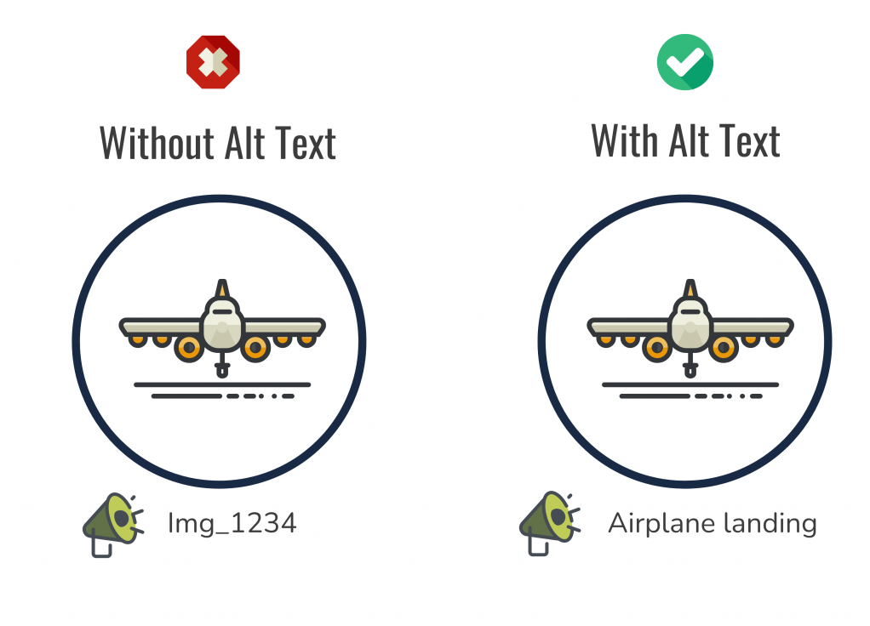
Alternative Text (Alt-Text)
Alt-text helps screen readers read visual content and should be added to every image.
If inserting alt-text is not an option, describe images in the body of the post. Platforms that provide alt-text options include Facebook, Instagram, LinkedIn, X/Twitter, YouTube and Pinterest.
You cannot add alt-text to stories, and, in some cases (LinkedIn and X), alt-text cannot be edited once it is posted.

Slide 17

Gifs, Emojis and Emoticons
There is limited support for animated GIFs on social media platforms.
Screen readers will read emojis appropriately, e.g., “clapping hands.” Do not overuse emojis and place a space between each one.
Emoticons, or representations of expressions created through a variety of keystrokes, e.g., :), will be read as “semi-colon parenthesis.”
Notes:
There is very little support for animated GIFs on social media platforms. Do not rely solely on animated GIFs to convey content.
Screen readers will read emojis appropriately, e.g., “clapping hands.” Do not overuse emojis and place a space between each one.
Emoticons, or representations of expressions created through a variety of keystrokes, e.g., :), will be read as “semi-colon parenthesis” and should be used sparingly if at all.

Slide 18
Additional Guidance
Avoid abbreviations.
Use hashtags only as needed and at the end of posts.
If a hashtag is crucial, use Pascal case (#ThisIsPascalCase)
Triple check for misspellings.
If you link to inaccessible content on social media platforms, let the user know.
Have someone test your social media content.
Notes:
Avoid abbreviations.
Use hashtags only as needed and at the end of posts.
If a hashtag is crucial, use Pascal case.
Triple check for misspellings.
If you link to inaccessible content on social media platforms, let the user know if it will auto-play, if there is no transcript or captions, etc.
Have someone test your social media content.

Slide 19
Platform Specific
Trista
ACTION STEPS

Slide 20
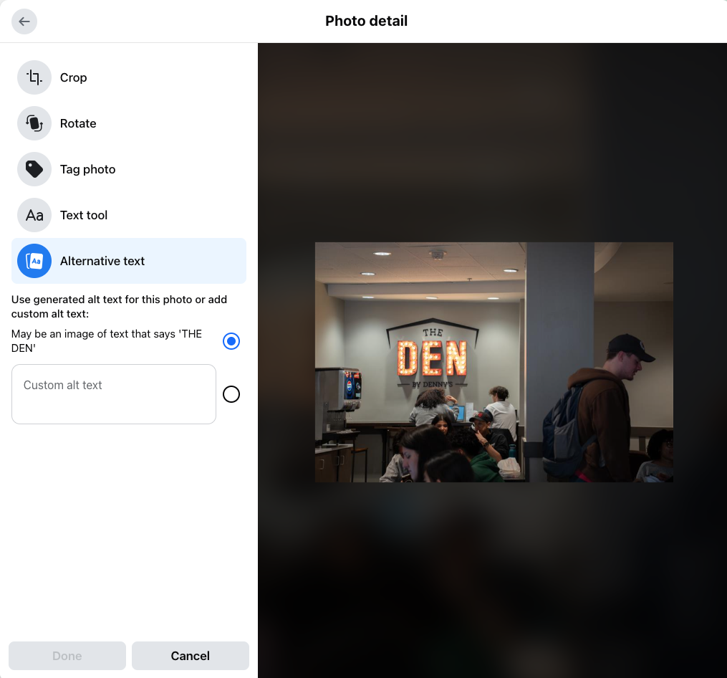
Facebook
Add captions to your videos.​
Alternatively, load videos to YouTube and add captions there, then link to the video in your posts.​
Link to transcripts for videos if possible.​
Check the color contrast in your images if you are conveying textual information.​
Notes:
Add captions to your Facebook videos.​
Alternatively, load videos to YouTube and add captions there, then link to the video in your posts.​
Link to transcripts for videos if possible.​
Check the color contrast in your images if you are conveying textual information.​
For Image: Create a post, add a photo, edit photo

Slide 21
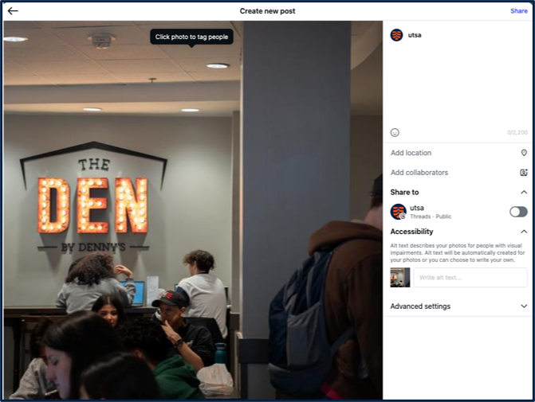
Instagram
Burn captions into your videos. Instagram does not support the addition of caption files to videos.
Check the color contrast in your images if you are conveying textual information.
Notes:
Burn captions into your videos. Instagram does not support the addition of caption files to videos, so you should burn captions into video files.
Check the color contrast in your images if you are conveying textual information.
When you are posting natively, once you get to the caption, you can click on the tab marked “Accessibility” to add alt-text.

Slide 22
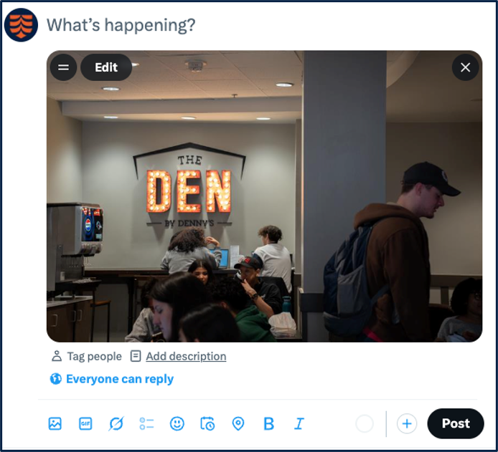
X (Twitter)
Burn subtitles into your videos.
Check the color contrast in your images if you are conveying textual information.
Notes:
Add subtitles to your X/Twitter videos. X does not support closed captions.
Check the color contrast in your images if you are conveying textual information.
Use Pascal case in your hashtags, e.g.,#ThisIsPascalCase. Use hashtags only as needed and at the end of posts.

Slide 23
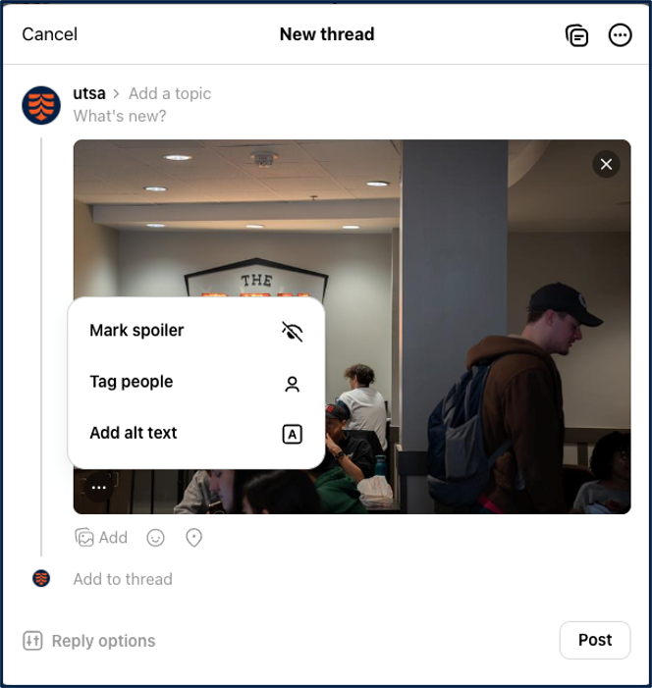
Threads
Add subtitles to your videos.
Check the color contrast in your images if you are conveying textual information.
Notes:
Add subtitles to your Threads videos. Threads does not support closed captions.
Check the color contrast in your images if you are conveying textual information.
Use Pascal case in your hashtags, e.g.,#ThisIsPascalCase. Use hashtags only as needed and at the end of posts.

Slide 24
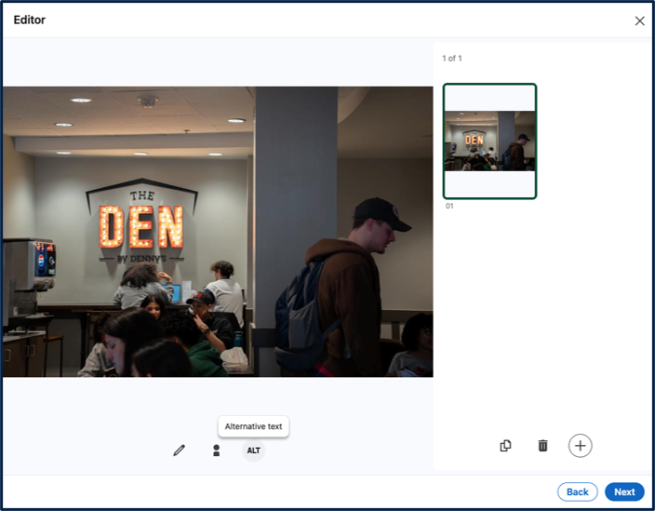
LinkedIn
Add captions to videos.
Link to transcripts if possible.
Make sure your profile photograph is clear and representative.
Check the color contrast in your images if you are conveying textual information.
Notes:
LinkedIn does not currently provide help documentation on adding alt-text to images.
Add captions to LinkedIn videos.
Link to transcripts for videos if possible.
Make sure your profile photograph is clear and representative.
People with Prosopagnosia(colloquially known as face blindness) may rely on your profile photo.
Check the color contrast in your images if you are conveying textual information.
Use Pascal case in your hashtags, e.g.,#ThisIsPascalCase. Use hashtags only as needed and at the end of posts.

Slide 25
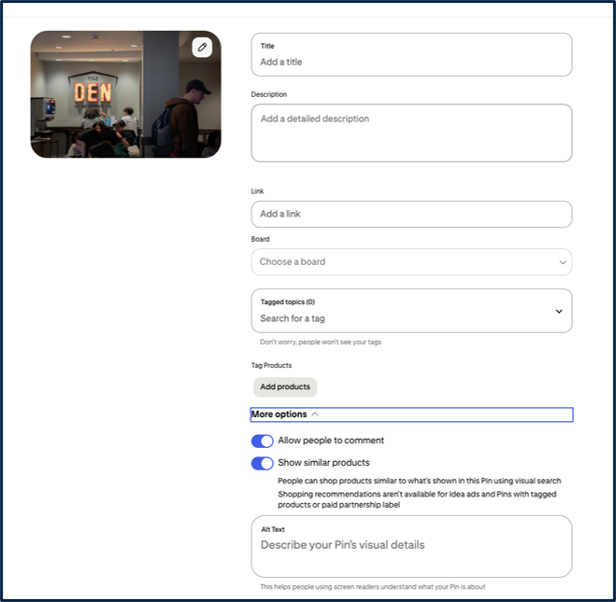
Pinterest
Add a description to your Pin when you create it.
Alternatively, create a Pin by adding a URL to an image that includes alt-text.
Consult Pinterest’s Best Practices for Inclusive Product Design for tips about accessibility options.
Notes:
Add a description to your Pin when you create it. If you are creating the pin from scratch (as shown), you can add alt text under “More Options.” If you are pinning something from a website, Pinterest does not support the addition of alt-text, so adding a good description is vital.
You can also make sure when. you create a Pin that you are adding a URL to an image that includes alt-text.
Pinterest does not support the addition of videos directly to its platform.
Consult Pinterest’s Best Practices for Inclusive Product Design for tips about accessibility options.

Slide 26
Alt-Text Best Practices
Trista
GUIDANCE

Slide 27
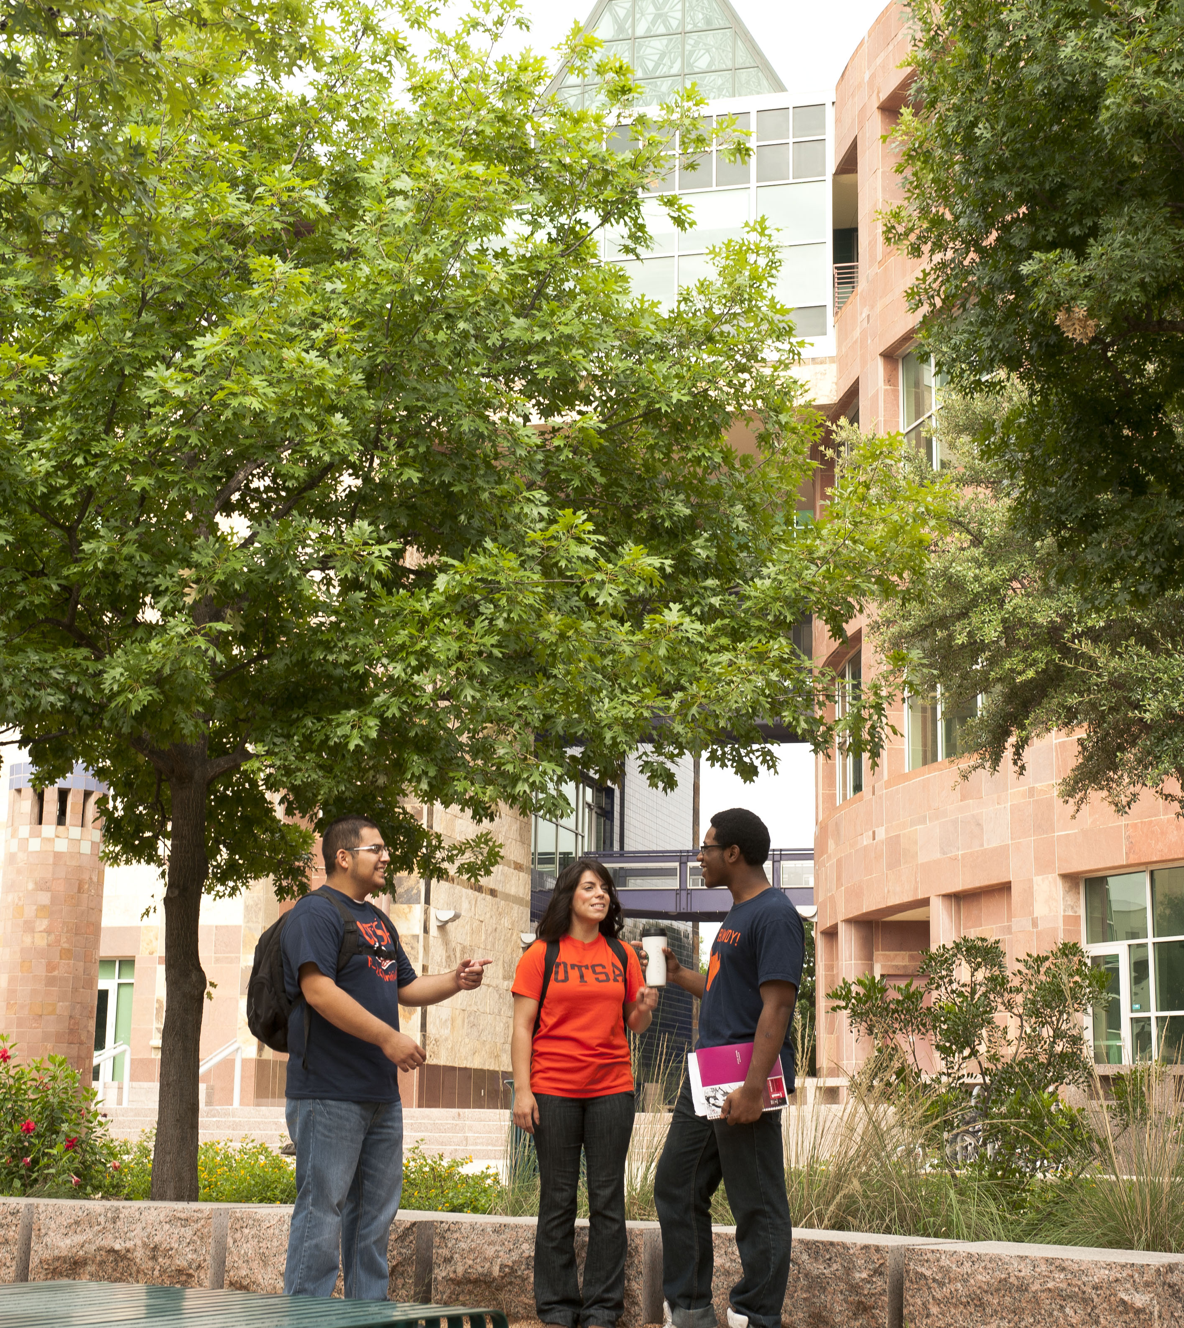
Try This!
Based on this photo, what do you think the alt-text should be?​
Share your suggestion in the meeting chat.

Slide 28
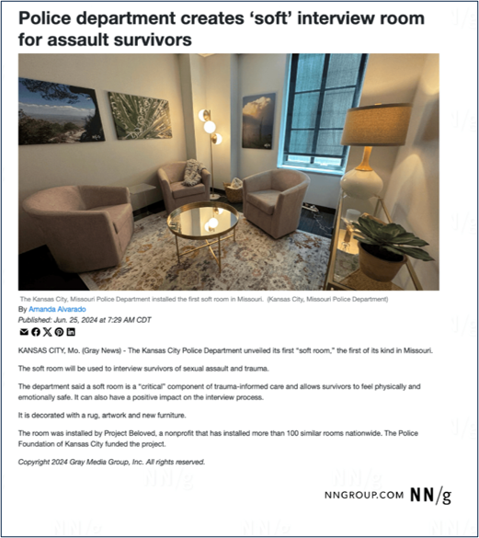
Keep It Short
Try to keep alt-text shorter than 150 characters. Users cannot pause and resume in the middle of alt-text without going back to the beginning.
Example: A small, inviting room with warm lighting, several cushioned chairs arranged to facilitate discussion, blankets, and calming photos on the walls.
Notes:
Too long: A room with two lamps, three chairs, a coffee table, a plant, a cabinet, a window and three paintings on the wall. The paintings depict a nature scene with blue sky, a cityscape in gray and a cloudy day. A rug covers the floor.

Slide 29
End With A Period.
Even if your alt-text isn't a full sentence, use a period. This ensures that the screen reader will pause after reading the
alt-text. ​

Slide 30
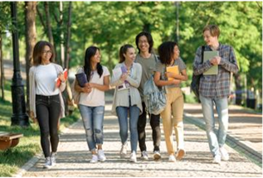
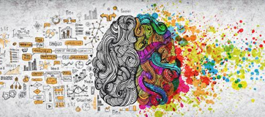
Don’t include words like “image” or “photo”
Screen readers auto-identify images because of the HTML tag.
However, if you’re publishing a specific type of image such as an infographic, chart or illustration, adding this word to your alt-text will improve accessibility.
Alt-Text: Group of young college students laugh and walk along a tree-lined pathway.
Alt-Text: Illustration of right and left-brain theory – left brain is black and white with ideas adjacent in nice organized text while right brain is vivid rainbow colors spilling out into dots of bright painted hues.

Slide 31

Avoid technical jargon and abbreviations
Use plain language as much as possible and spell out abbreviations.
Alt-text with unnecessary jargon: A cancer scientist studying histopathology biopsy images by examination of microscopic tissue structure using a microscope in our laboratories.
Alt-text in plain language: A cancer scientist using a microscope in one of our laboratories.
Notes:
Examples in image:
Alt-text with unnecessary jargon: “A cancer scientist studying histopathology biopsy images by examination of microscopic tissue structure using a microscope in our laboratories.”
Alt-text in plain language: “A cancer scientist using a microscope in one of our laboratories.”

Slide 32
Additional Guidance
Use alt-text to add value
Keep your key messages in mind. Consider why the image is part of your post and share the value it adds. To keep alt-text as concise as possible, do not repeat key words.
Are descriptors necessary?
If the race, ethnicity, gender, religion or cultural identifiers of the people pictured aren't part of the reason the image was included, do not mention them. Likewise, only reference a color in alt-text if it offers crucial meaning to the post.
AI cannot write alt-text alone
AI can help refine alt-text or give you a starting point to refine alt-text, but it cannot give you good alt-text without a human touch at this point.

Slide 33
Try This!
Share your alt-text suggestion in the meeting chat.
Context: The social media post is celebrating the Downtown Campus and its various programs.

Slide 34
REMEMBER
Compliance Takes Time
The most important thing to do is start the process now and reach out to the Digital Accessibility Team for assistance.

Slide 36
Appendix – Additional References
Yale – GIFs and Emoji Guidance
Oregon State University (includes TikTok) – Alt Text in Social Media
Harvard – Write helpful Alt Text to describe images
University of Minnesota – Alternative Text Guidance
University of South Carolina – Social Media & Alt Text
Accessible Social – Best Practices for Social Media
American Foundation for the Blind – Writing Effective Image Descriptions or "Alt Text"
Vision Australia – Five Tips for Writing Alt-text
U.S. General Services Administration – Authoring Meaningful Alternative Text
NN Group – Alt Text: What to Write
Accessibility Made Easy – Alternative text on social media

Slide 37
Getting Started
Your Journey Begins Here
The university’s ADA team has developed detailed pre-built plans, trainings, tools, and more broken down by the programs and materials that you use every day
Scan the code or visit
www.utsa.edu/ada/compliance2026/resources.html

